Slide 1
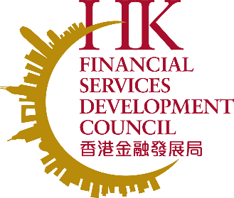
FSDC Industry Exchange Series Trailblazing for Change: Hong Kong, the Impact Investing Hub of Asia September 2024

Slide 2
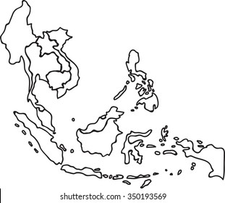
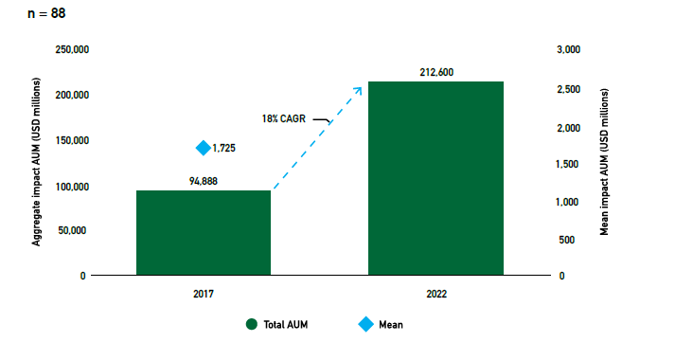
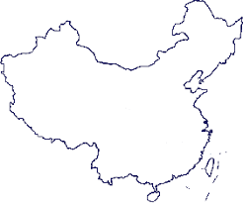
Impact investing at a glance
Impact Investing in the World and Asia
Opportunities for Hong Kong
Growth of total AUM in impact investments over a five-year period
The Rise of Impact Investing Opportunities in ASEAN
The number of impact deals available in ASEAN presents great opportunities for investors in Hong Kong.
Between 2020 and 2022, a total of 379 impact deals in the region channelled impact capital amounting to US$ 6.9 billion into enterprises, indicating a significant infusion of funds to generate positive social and environmental outcomes.
Potential Opportunities on the Mainland
The estimated size of the global impact investing market reached US$1.2 trillion in 2022
The total AUM of impact investment made by survey respondents grew by an average of around 18% per year between 2017 and 2022
Asia has experienced substantial growth in allocation rates since 2017. In East Asia, the amount of impact capital AUM increased from US$6.8 trillion in 2017 to US$17.9 trillion in 2022, representing a CAGR of 21%. South Asia witnessed a CAGR of 15% during the same period.
China's ambitious goals of achieving carbon peaking and carbon neutrality in a shorter timeframe than other countries, coupled with the immense challenge of reducing carbon emissions, represent a significant funding demand.
For instance, the investment required to support these initiatives is estimated to be between RMB 2.6 and 4.2 trillion annually, with a total scale of over one hundred trillion yuan.
Source: GIIN, CASVI, Investing in Women

Slide 3
Challenges Faced by Impact Investors in Hong Kong
Limited awareness and education on impact investing
Challenges to developing impact strategies
► Overcoming perceptions of risk and return
► Lack of guidance and incentives for investors to develop impact strategies
The hesitancy to explore impact investing as a viable investment approach stems from a limited understanding of its benefits and the persistent "trade-off" myth, which suggests a perceived trade-off between financial returns and social impact.
The absence of standardised measurement mechanisms exacerbates the challenge. Many measurement frameworks are available to investors which serve the same purpose of quantifying impact based on various mechanisms
► Lack of impact investing education for investors
► Scarcity in impact investing deals and impact investment managers with track records in HK
Impact investing is relatively new and requires specialised knowledge and skills. The lack of educational programmes and resources tailored specifically to impact investing prevents investors from acquiring the necessary understanding and expertise to engage in impact investment opportunities.
The lack of impact investing deals presents a significant challenge for investors seeking to allocate capital towards projects that generate positive social and environmental outcomes. The limited track records of impact investment managers in Hong Kong and the broader region pose challenges in attracting investments from impact investors and intermediaries who prioritise proven experience.

Slide 4
Policy Recommendations
Building an ecosystem for impact investing to thrive in Hong Kong
Awareness raising:
Empowering
well-intentioned investors
Prioritising SDGs and encouraging early adoption of impact frameworks
Setting an example through direct government involvement
Capacity building:
Enhancing education with a multifaceted approach
Incentivising impact:
Creating a conducive environment for impact investment
Empowering retail investors through increased investor education
Enriching asset owners’ expertise through collaborative partnerships and industry engagement
Cultivating early through higher education
Enhancing the ease of incorporation
Promoting investing with purpose

Slide 5
Policy Recommendations
Awareness raising: Empowering well-intentioned investors
Recommendation 1: Prioritising SDGs and encouraging early adoption of impact frameworks
Prioritising associated international frameworks for sustainable development, specifically the SDGs, would be one of the important elements.
Promoting the adoption and incorporation of an impact framework early in investors’ early decision-making process, on top of relying solely on the prioritisation of SDGs.
Recommendation 2: Setting an example through direct government involvement
The HKIC can allocate a portion of its investment portfolio specifically to impact investments aligned with the SDGs. By taking this leadership role, the HKIC can establish a benchmark that provides valuable guidance to new investors to impact investing.
The Government can establish PPPs and collaborate with impact-focused organisations to catalyse investments in areas aligned with the SDGs.

Slide 6
Policy Recommendations
Capacity building: Enhancing education with a multifaceted approach
Recommendation 3: Empowering retail investors through increased investor education
There is an opportunity for the IFEC to expand its resources and establish a dedicated section specifically focused on impact investment.
The GSF Knowledge Hub website could also be expanded to include dedicated sections on impact investing.
Recommendation 4: Enriching asset owners’ expertise through collaborative partnerships and industry engagement
Institutions such as the HKAWL and other platform builders in Hong Kong can help bridge the knowledge gap by organising educational events, conferences, and industry forums focused on impact investing.
The Government can work closely with industry associations, academic institutions, impact investing networks, and international organisations.
Recommendation 5: Cultivating early through higher education
By integrating impact investment into relevant disciplines such as finance, business, economics, and sustainability, universities can equip students with the necessary knowledge and skills to navigate the evolving landscape of responsible and sustainable finance.

Slide 7
Policy Recommendations
Incentivising impact: Creating a conducive environment for impact investment
Recommendation 6: Enhancing the ease of incorporation
To accelerate the growth of impact investing in Hong Kong, relevant public stakeholders could consider introducing incentives to encourage the establishment and registration of impact investment funds in the city
The Government can offer other supportive measures to incentivise the establishment of impact investment funds. These could include expedited approval procedures, relevant tax incentives, expansion of ESG fund definition if deemed appropriate, and dedicated support services for fund managers to navigate the complexities of impact investing.
Recommendation 7: Promoting investing with purpose
To further enhance the impact of the CIES and create a more dynamic impact investment landscape in Hong Kong, relevant public stakeholders could consider including impact investments as one of the permissible investment assets, alongside equities and debt securities.

Slide 8
Thank you

